Slide 1

Predictive Learning
from Data
LECTURE SET 10
Nonstandard Learning Approaches
Electrical and Computer Engineering

Slide 2
OUTLINE
Motivation
- Standard inductive learning and its limitations
- Conceptual issues and mew developments
- Formalizing application requirements
New Learning Settings
Summary

Slide 3


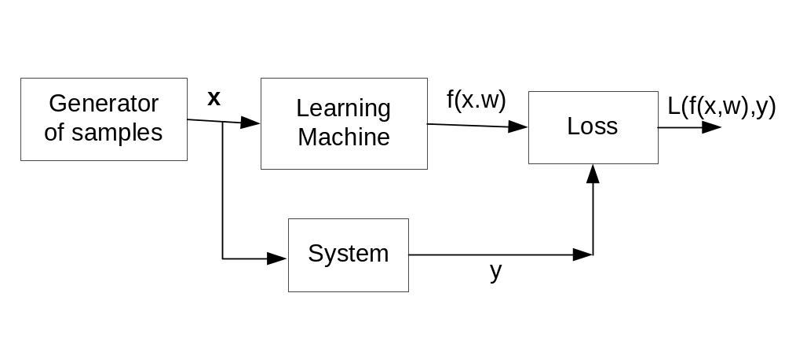
Inductive Learning Setting
The learning machine observes samples (x ,y), and returns an estimated response
Given training data (x ,y), select one ‘best’ function from (infinite) number of possible functions (admissible models)
Best model provides

Slide 4
Classical VC-theory
VC-theory describes all machine learning (ML) methods based on ERM (~ fitting training data)
VC-theory provides theoretical conditions stating that:
good generalization is possible if we can achieve small training error using a set of functions with small VC-dim.
SVM technology ~ flexible class of learning algorithms based on VC-theory + solid math
VC-theory does not discuss how to choose ‘good’ parameterization, i.e. set of admissible functions f(x, w)
All ML methods assume inductive learning but differ in:
(a) parameterization (of admissible models) and
(b) optimization method

Slide 5
Conceptual Issues and New Developments
Standard inductive learning: is it the best choice for ML ?
What is the role of a Teacher?
- under inductive setting, Teacher provides ‘answers’
- Human teachers do much more than that
Is it possible to find good parameterization ? ~ e.g. flexible set of functions providing superior performance for wide range of applications (aka Universal Intelligence)
New Development 1: Deep Learning + Big Data e.g. special parameterization + a lot of data → intelligence
New Development 2: New Learning Formulations beyond standard inductive learning, e.g.
(a) rich & more_complex data
(b) ‘intelligent’ teacher

Slide 6
Deep Learning Networks
Standard inductive learning: training data (x, y)
Parameterization: Multilayer Network + backprop.
What is new ? (vs original work in 1980’s and 90’s)
No new theoretical results
Much more powerful computers
Very large data sets
Empirical results (good performance)
‘Similarity’ to biological learning
Main claim: DL is better than Shallow Learning
Main supporting arguments:
- automatic feature selection
- performance on image data (competitions)

Slide 7
Some Empirical Testing
ImageNet model summary:
DL model trained on millions of natural images
Winner of competition
Superior recognition performance 99.xx%
Claim of intelligence/ better than human recognition
Trained ImageNet model is publicly available
→ can be used for testing on new images

Slide 8

Testing ImageNet

Slide 9
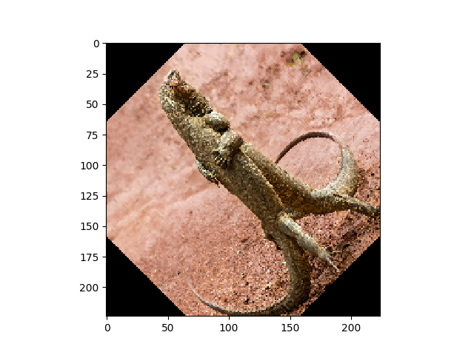
Testing ImageNet

Slide 10
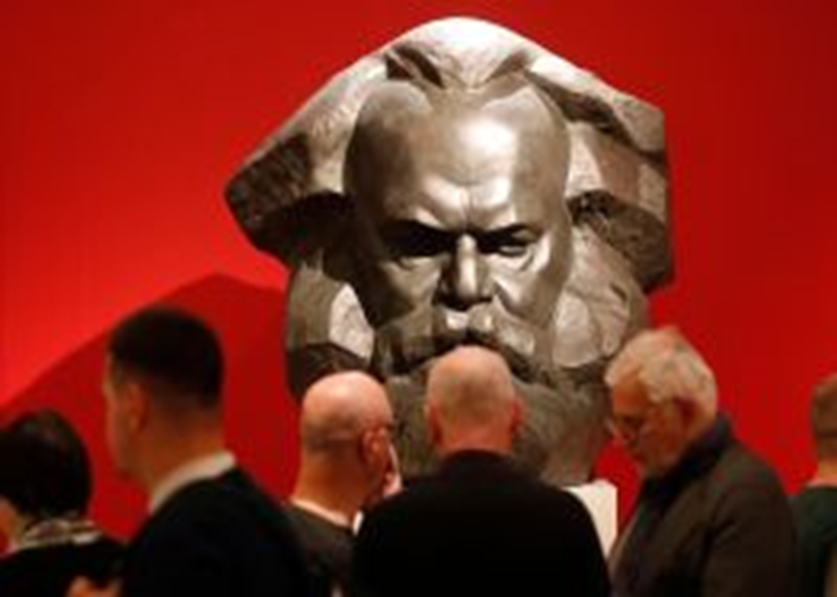
Testing ImageNet
ImageNet prediction
‘ Mask’ class

Slide 11
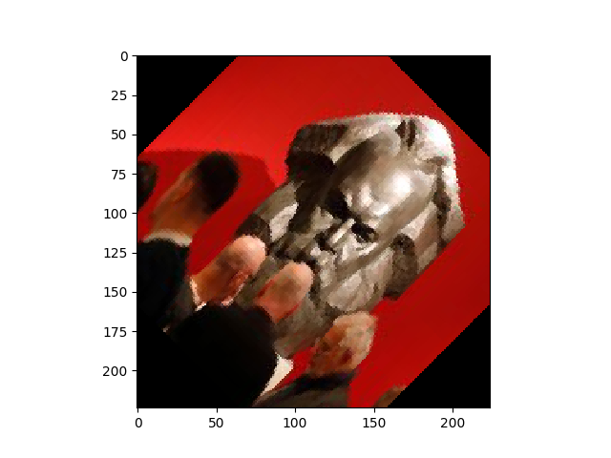
Testing ImageNet
ImageNet prediction Red wine

Slide 12
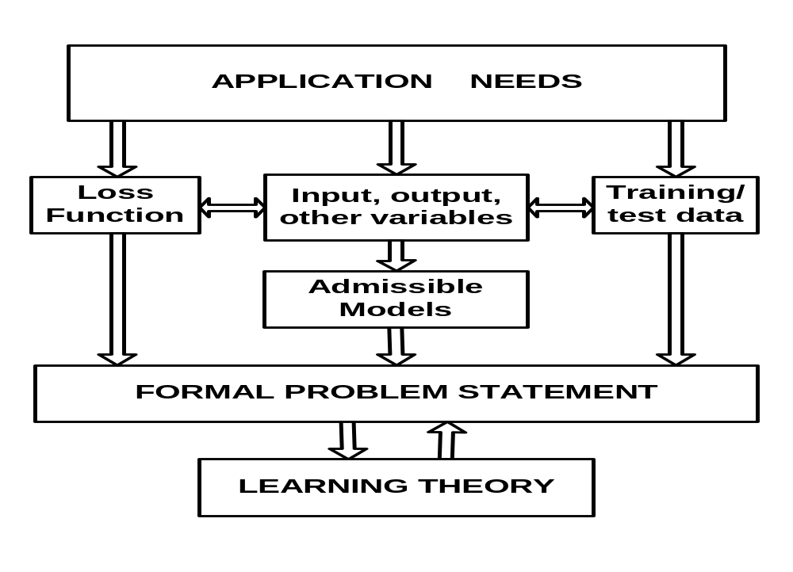
Formalizing Application Requirements
Conventional ML: assume standard inductive setting
Modern applications: complex data/ multiple data sources
→ Non-standard (alternative) formulation may be better!

Slide 13
How to improve generalization for HDLSS?
Conventional approaches use
Standard inductive learning + a priori knowledge:
Preprocessing and feature selection (preceding learning)
Model parameterization (~ selection of good kernels in SVM)
Informative prior distributions (in statistical methods)
Non-standard learning formulations
Seek new generic formulations (not methods!) that better reflect application requirements
A priori knowledge + additional data are used to derive new problem formulations

Slide 14
Two Aspects of Human Intelligence
Multiple sources of data:
visual, audio, … etc
Example: perception of songs in foreign language
Intelligent Teacher:
provides explanations + hints + useful associations, not just answers
These two aspects of intelligent learning can be formalized via VC-methodology

Slide 15
VC-theoretical approach
Focus on the learning setting/formulation, not on learning method (algorithm)
Learning formulation depends on:
(1) available data (multiple types/sources)
(2) application requirements
(3) a priori knowledge (assumptions)
Combination of factors (1)-(3) typically yields non-standard learning formulation

Slide 16
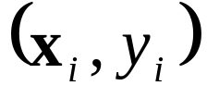
Examples of Nonstandard Settings
Standard Inductive setting, e.g., digits 5 vs. 8
Finite training set
Predictive model derived using only training data
Prediction for all possible test inputs
Possible modifications
- Transduction: Predict only for given test points
- Universum Learning: available labeled data ~ examples of digits 5 and 8 and unlabeled examples ~ other digits
- Learning Using Privileged Information (LUPI):
training samples include additional information (e.g., linguistic description of digits)
- Multi-Task Learning:
training data ~ t groups (from different persons)

Slide 17
SVM-style Framework for New Settings
Conceptual Considerations:
Additional info/ knowledge → new problem setting
→ new type/ new implementation of SRM principle
Technical Considerations:
New knowledge encoded as additional constraints on admissible functions (under SVM-like setting)
Practical Significance:
- new settings directly comparable to standard SVM
- standard SVM is a special case of a new setting
- optimization s/w for new settings usually require minor modifications of (existing) standard SVM s/w

Slide 18
OUTLINE
Motivation
New Learning Settings
Additional sources of data (during training):
→ Transduction, Universum Learning
Additional knowledge from the Teacher:
→ Learning Using Privileged Info (LUPI), Learning Using Statistical Invariants (LUSI)
Note 1: all new settings assume binary classification
Note 2: SVM formulations shown/ nonSVM possible
Summary

Slide 19

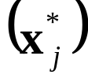


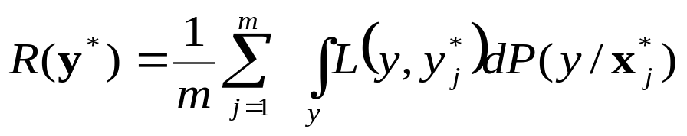

Transduction (Vapnik, 1982, 1995)
How to incorporate unlabeled test data into learning process? Assume binary classification
Estimating a function at known test points
Given: labeled training data
and unlabeled test points
Estimate: class labels at these test points
Goal of learning: minimization of risk for test set:
where

Slide 20
Transduction vs Induction
a priori knowledge
~ assumptions
estimated
function
induction
deduction
training
predicted
data
output
transduction

Slide 21
Transduction based on size of margin
Binary classification, linear parameterization, joint set of (training + working) samples
Note: working sample = unlabeled test point
Simplest case: single unlabeled (working) sample
Goal of learning
(1) explain well available data (~ joint set)
(2) achieve max falsifiability (~ large margin)
~ Classify test (working + training) samples by the largest possible margin hyperplane (see below)

Slide 22
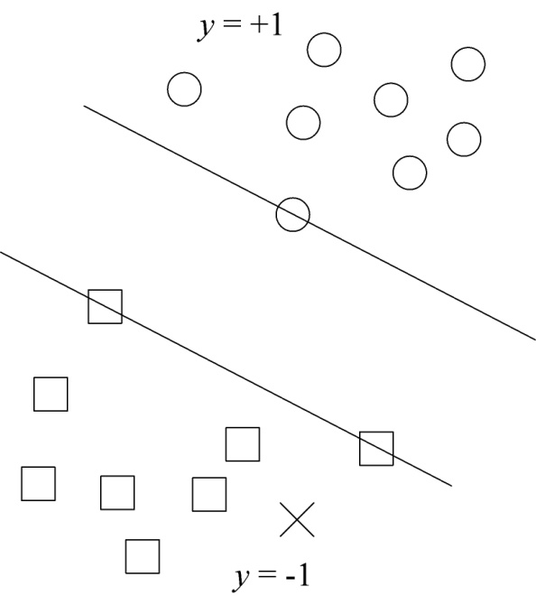
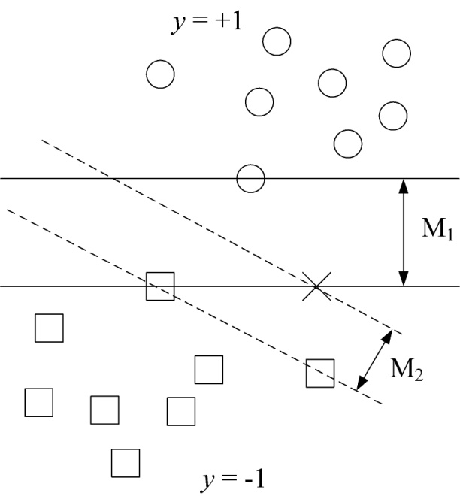
Margin-based Local Learning
Special case of transduction: single working point
How to model many unlabeled samples?

Slide 23
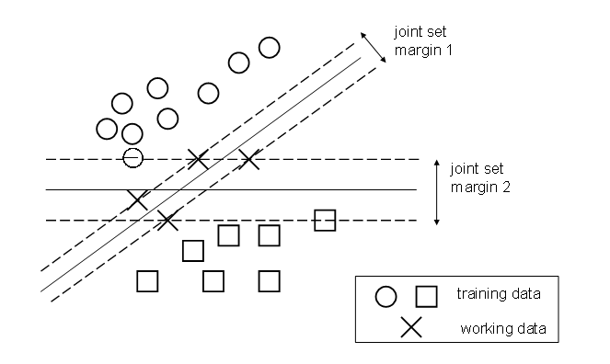
Transduction based on size of margin
Transductive SVM learning has two objectives:
(TL1) separate labeled data using large-margin hyperplane ~ as in standard SVM
(TL2) separate working data using large-margin hyperplane

Slide 24
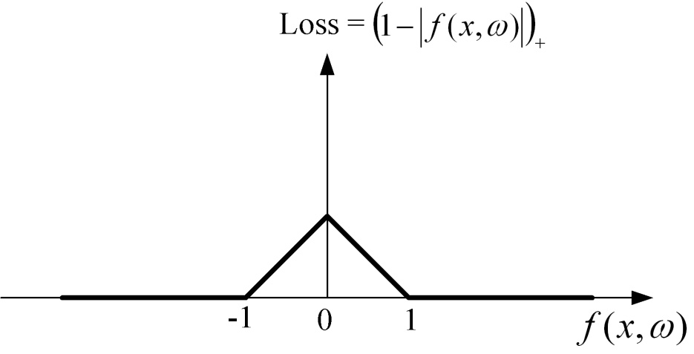
Loss function for unlabeled samples
Non-convex loss function:
Transductive SVM constructs a large-margin hyperplane for labeled samples AND forces this hyperplane to stay away from unlabeled samples

Slide 25


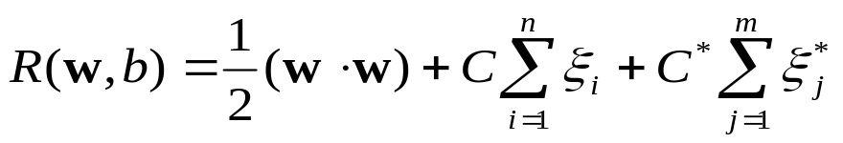
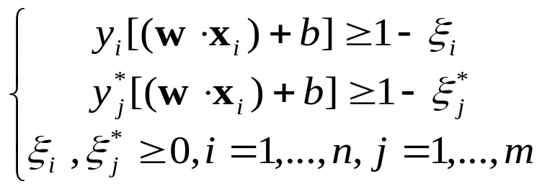


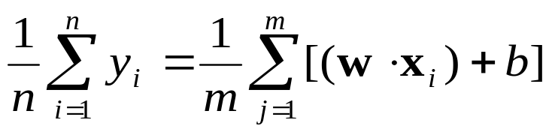
Optimization formulation for SVM transduction
Given: joint set of (training + working) samples
Denote slack variables for training, for working
Minimize
subject to
where ~ labels for working
→ Solution (~ decision boundary)
Unbalanced situation (small training/ large test)
→ all unlabeled samples assigned to one class
Additional constraint:

Slide 26
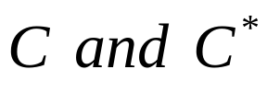
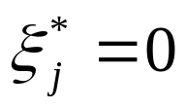
Optimization formulation (cont’d)
Hyperparameters control the trade-off between explanation and falsifiability
Soft-margin inductive SVM is a special case of soft-margin transduction with zero slacks
Dual + kernel version of SVM transduction
Transductive SVM optimization is not convex
(~ non-convexity of the loss for unlabeled data) – **explain**
→ different opt. heuristics ~ different solutions
Exact solution (via exhaustive search) possible for small number of test samples (m) – but this solution is NOT very useful (~ inductive SVM).

Slide 27
Many applications for transduction
Text categorization: classify word documents into a number of predetermined categories
Email classification: Spam vs non-spam
Web page classification
Image database classification
All these applications:
- high-dimensional data
- small labeled training set (human-labeled)
- large unlabeled test set

Slide 28
Example application
Prediction of molecular bioactivity for drug discovery
Training data~1,909; test~634 samples
Input space ~ 139,351-dimensional
Prediction accuracy:
SVM induction ~74.5%; transduction ~ 82.3%
Ref: J. Weston et al, KDD cup 2001 data analysis: prediction of molecular bioactivity for drug design – binding to thrombin, Bioinformatics 2003

Slide 29
Semi-Supervised Learning (SSL)
SSL assumes availability of labeled + unlabeled data (similar to transduction)
SSL has a goal of estimating an inductive model for predicting new (test) samples – different from transduction
In machine learning, SSL and transduction are often used interchangeably, i.e. transduction can be used to estimate SSL model.
SSL methods usually combine supervised and unsupervised learning methods into one algorithm

Slide 30
SSL and Cluster Assumption
Cluster Assumption: real-life application data often has clusters, due to (unknown) correlations between input variables. Discovering these clusters using unlabeled data helps supervised learning
Example: document classification and info retrieval
- individual words ~ input features (for classification)
- uneven co-occurrence of words (~ input features) implies clustering of documents in the input space
- unlabeled documents can be used to identify this cluster structure, so that just a few labeled examples are sufficient for constructing a good decision rule

Slide 31
Toy Example for Text Classification
Data Set: 5 documents that need to be classified into 2 topics ~ “Economy’ and ‘Entertainment’
Each document is defined by 6 features (words)
- two labeled documents (shown in color)
- need to classify three unlabeled documents
Apply clustering → 2 clusters (x1,x3) and (x2,x4,x5)
 | Budget deficit | Music | Seafood | Sex | Interest Rates | Movies
L1 | 1
L2 |  |  | 1 | 1 |  | 1
U3 | 1 |  |  |  | 1
U4 |  | 1
U5 |  | 1 | 1

Slide 32
Self-Learning Method (example of SSL)
Given initial labeled data set L and unlabeled set U
Repeat:
(1) estimate a classifier using L
(2) classify randomly chosen unlabeled sample using the decision rule estimated in Step (1)
(3) move this new labeled sample to L
Iterate steps (1)-(3) until all unlabeled samples are classified

Slide 33
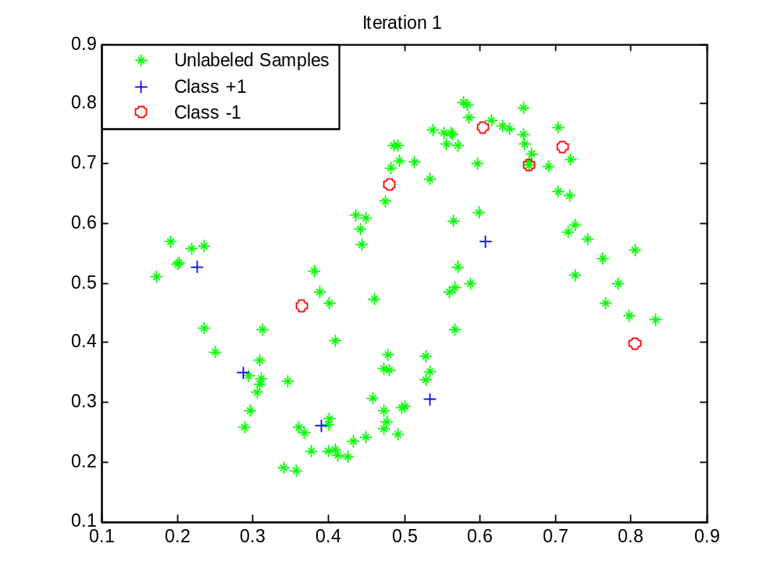
Illustration (using 1-nearest neighbor classifier)
Hyperbolas data:
- 10 labeled and 100 unlabeled samples (green)

Slide 34
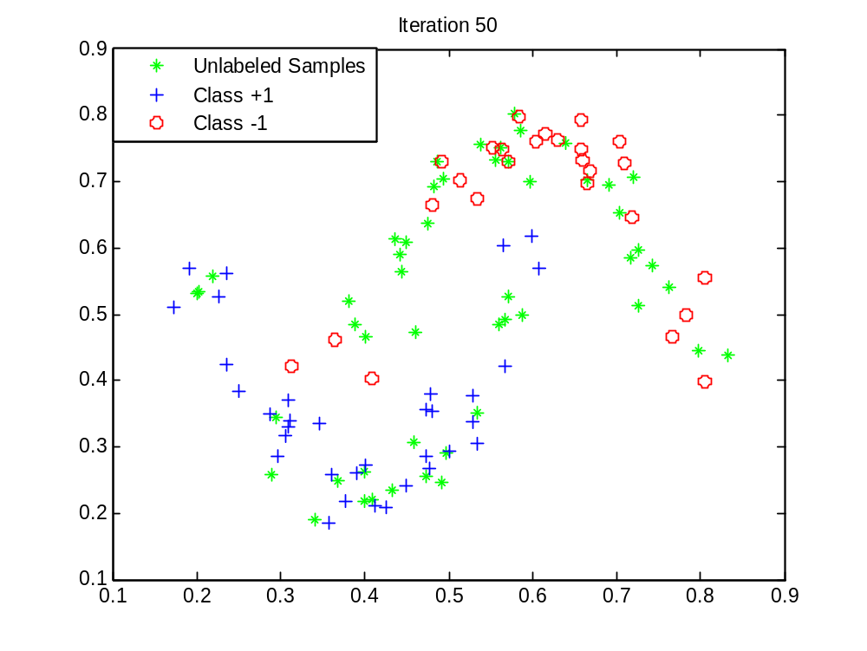
Illustration (after 50 iterations)

Slide 35
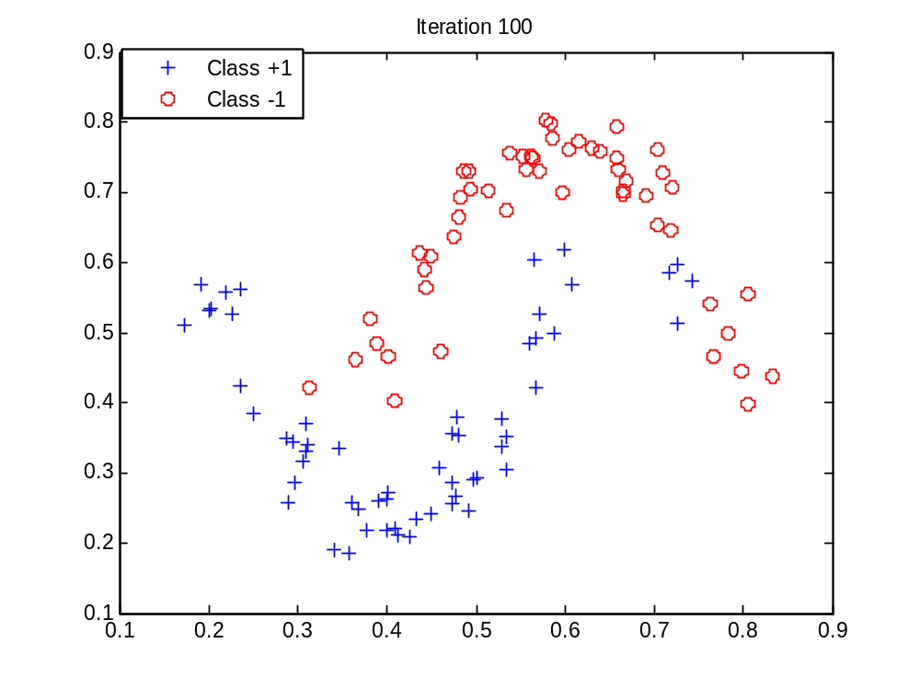
Illustration (after 100 iterations)
All samples are labeled now:

Slide 36
Comparison: SSL vs T-SVM
Comparison 1 for low-dimensional data:
- Hyperbolas data set (10 labeled, 100 unlabeled)
- 10 random realizations of training data
Comparison 2 for high-dimensional data:
- Digits 5 vs 8 (100 labeled, 1,866 unlabeled)
- 10 random realizations of training/validation data
Note: validation data set for SVM model selection
Methods used
- Self-learning algorithm (using 1-NN classification)
- Nonlinear T-SVM (needs parameter tuning)

Slide 37
Comparison 1: SSL vs T-SVM and SVM
Methods used
- Self-learning algorithm (using 1-NN classification)
- Nonlinear T-SVM (Poly kernel d=3)
Self-learning method is better than SVM or T-SVM
- Why?
HYPERBOLAS DATA SET
SETTING σ=0.025, No. of training and validation samples=10 (5 per class). No. of test samples= 100 (50 per class).
 | Polynomial SVM(d=3) | T-SVM(d=3) | Self-Learning
Prediction Error ( %) | 11.8(2.78) | 10.9(2.60) | 4.0(3.53)
Typical Parameters | C= 700-7000 | C*/C= 10⁻⁶ | N/A

Slide 38
Comparison 2: SSL vs T-SVM and SVM
Methods used
- Self-learning algorithm (using 1-NN classification)
- Nonlinear T-SVM (RBF kernel)
SVM or T-SVM is better than self-learning method
- Why?
MNIST DATA SET
SETTING: No. of training and validation samples=100. No. of test samples= 1866.
 | RBF SVM | RBF T-SVM | Self-Learning
Test Error ( %) | 5.79(1.80) | 4.33(1.34) | 7.68(1.26)
Typical selected parameter values | C≈ 0.3- 7 gamma≈5⁻³-5⁻² | C*/C≈0.01-1 | N/A

Slide 39
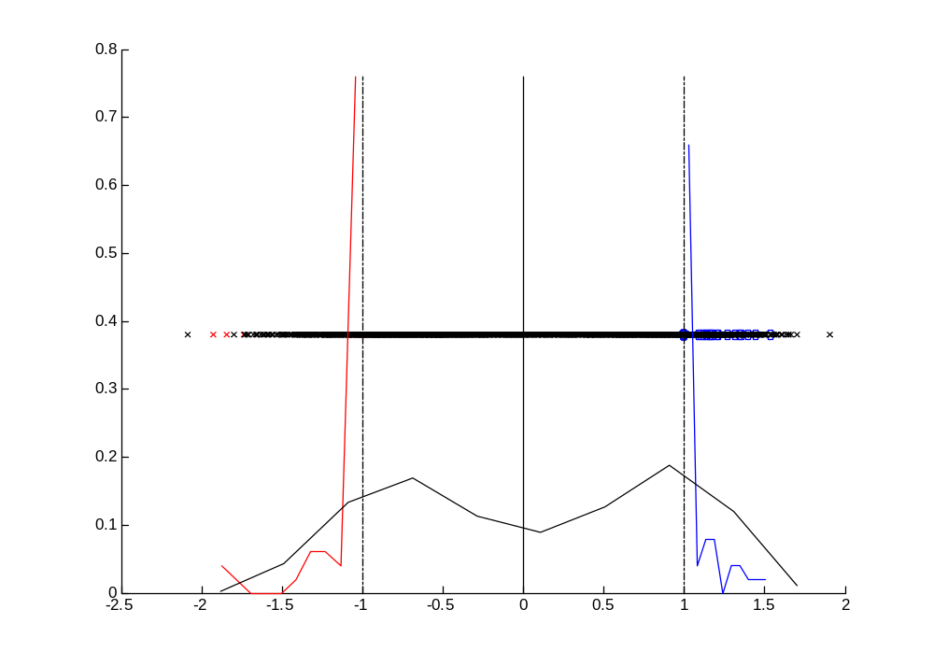
Explanation of T-SVM for digits data set
Histogram of projections of labeled + unlabeled data:
- for standard SVM (RBF kernel) ~ test error 5.94%
- for T-SVM (RBF kernel) ~ test error 2.84%
Histogram for RBF SVM (with optimally tuned parameters):

Slide 40
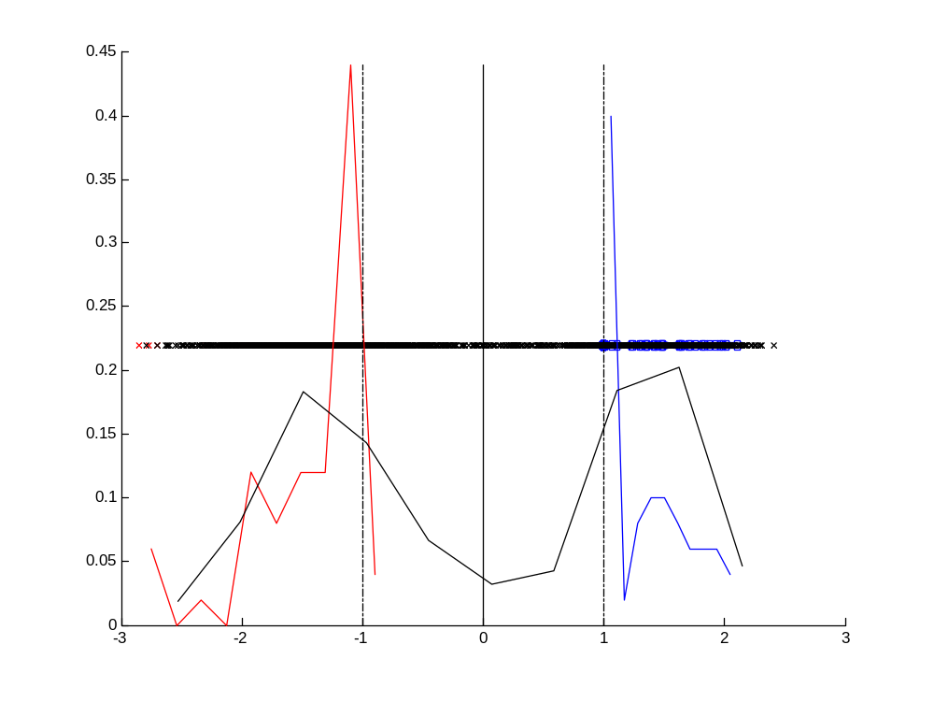
Explanation of T-SVM (cont’d)
Histogram for T-SVM (with optimally tuned parameters)
Note: (1) test samples are pushed outside the margin borders
(2) more labeled samples project away from margin

Slide 41
Universum Learning (Vapnik 1998, 2006)
Motivation: what is a priori knowledge?
- info about the space of admissible models
- info about admissible data samples
Labeled training samples (as in inductive setting) + unlabeled samples from the Universum
Universum samples encode info about the region of input space (where application data lives):
- from a different distribution than training/test data
- U-samples ~ neither positive nor negative class
Examples of the Universum data
Expect large improvement for small sample size n

Slide 42
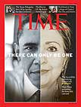
Cultural Interpretation of the Universum
Absurd examples, jokes, some art forms
neither Hillary nor Obama but looks like both

Slide 43
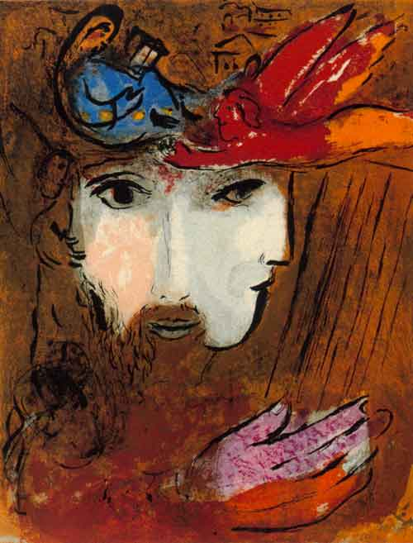
Cultural Interpretation of the Universum
Marc Chagall:
FACES

Slide 44
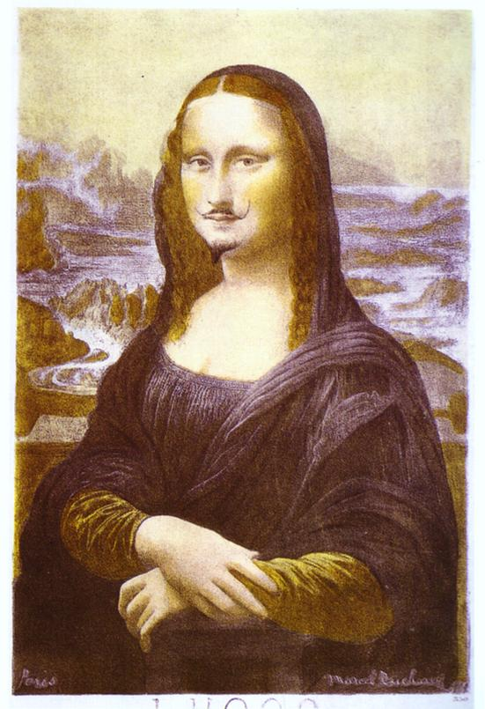
Cultural Interpretation of the Universum
Some art forms
surrealism, dadaism
Marcel Duchamp (1919)
Mona Lisa with Mustache

Slide 45
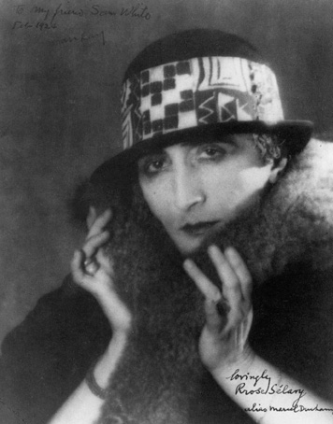
More on Marcel Duchamp
Rrose Sélavy (Marcel Duchamp), 1921, Photo by Man Ray.

Slide 46
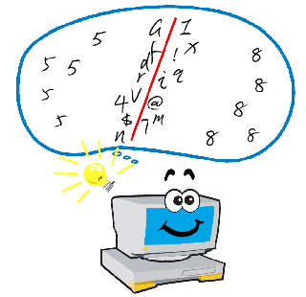
Main Idea of Universum Learning
Handwritten digit recognition: digit 5 vs 8
Fig. courtesy of J. Weston (NEC Labs)

Slide 47
Learning with the Universum
Inductive setting for binary classification
Given: labeled training data
and unlabeled Universum samples
Goal of learning: minimization of prediction risk (as in standard inductive setting)
Two goals of Universum Learning:
(UL1) separate/explain labeled training data using large-margin hyperplane (as in standard SVM)
(UL2) maximize the number of contradictions on the Universum, i.e. Universum samples inside the margin
Goal (UL2) is achieved by using special loss function for Universum samples

Slide 48
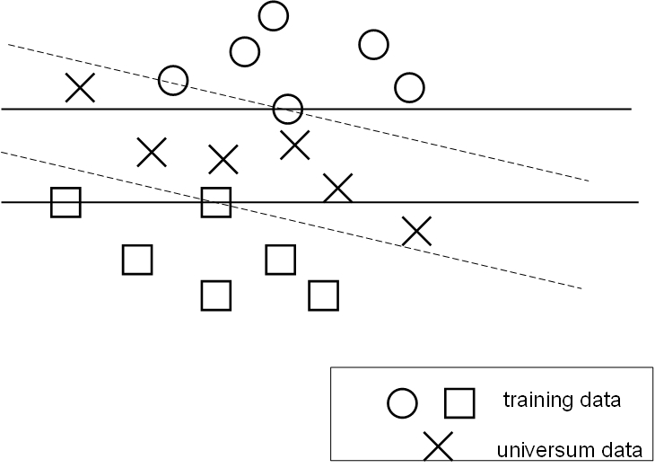
Inference through contradictions

Slide 49
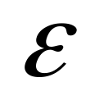
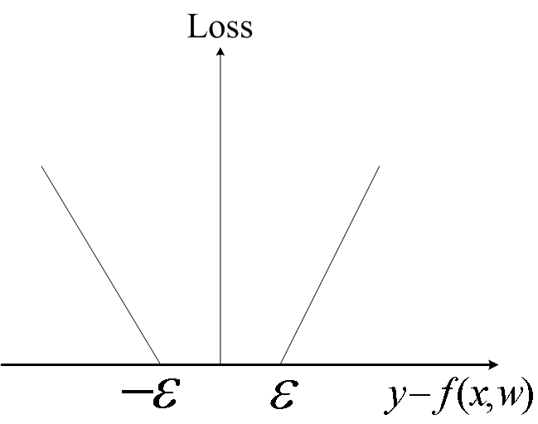





-insensitive loss for Universum samples

Slide 50







Universum SVM Formulation (U-SVM)
Given: labeled training + unlabeled Universum samples
Denote slack variables for training, for Universum
Minimize where
subject to for labeled data
for the Universum
where the Universum samples use -insensitive loss
Convex optimization
Hyper-parameters control the trade-off btwn minimization of errors and maximizing the # contradictions
When =0, → standard soft-margin SVM

Slide 51
Application Study (Vapnik, 2006)
Binary classification of handwritten digits 5 and 8
For this binary classification problem, the following Universum sets had been used:
U1: randomly selected other digits (0,1,2,3,4,6,7,9)
U2: randomly mixing pixels from images 5 and 8
U3: average of randomly selected examples of 5 and 8
Training set size tried: 250, 500, … 3,000 samples
Universum set size: 5,000 samples
Prediction error: improved over standard SVM, i.e. for 500 training samples: 1.4% vs 2% (SVM)

Slide 52
Universum U3 via random averaging (RA)
Class 1
Average
Hyper-plane
Class -1

Slide 53



Random Averaging for digits 5 and 8
Two randomly selected examples
Universum sample:

Slide 54
Application Study: gender of human faces
Binary classification setting
Difficult problem:
dimensionality ~ large (10K - 20K)
labeled sample size ~ small (~ 10 - 20)
Humans perform very well for this task
Issues:
- possible improvement (vs standard SVM)
- how to choose Universum?
- model parameter tuning

Slide 55
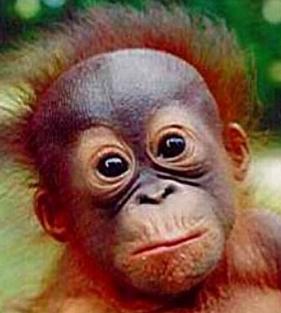
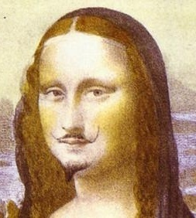

Universum Faces: neither male nor female

Slide 56






Empirical Study (Bai and Cherkassky 2008)
Gender classification of human faces (male/ female)
Data: 260 pictures of 52 individuals (20 females and 32 males, 5 pictures for each individual) from Univ. of Essex
Data representation and pre-processing: image size 46x59 – converted into gray-scale image, following standard image processing (histogram equalization)
Training data: 5 female and 8 male photos
Test data: remaining 39 photos (of other people)
Experimental procedure: randomly select 13 training samples (and 39 test samples). Estimate and compare inductive SVM classifier with SVM classifier using N Universum samples (where N=100, 500, 1000).
- Report results for 4 partitions (of training and test data)

Slide 57
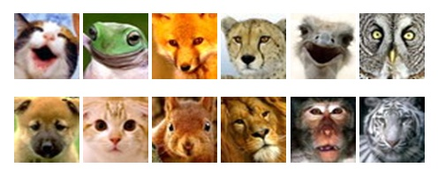
Empirical Study (cont’d)
Universum generation:
U1 Random Average: of male and female samples randomly selected from the training set.
U2 Empirical Distribution: estimate pixel-wise distribution of the training data (both male+female). Generate a new picture from this distribution.
U3 Animal faces:

Slide 58








Universum generation: examples
U1 Averaging:
U2 Empirical Distribution:

Slide 59
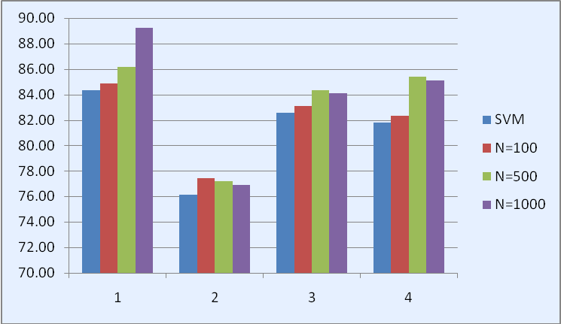
Results of gender classification
Classification accuracy: improves vs standard SVM by ~ 2% with U1, and ~ 1% with U2 Universum
RA Universum works best when # Universum samples N = 500 or 1,000 (shown above for 4 partitionings of the data)
Animal face Universum degrades performance by 2-5%

Slide 60
Random Averaging Universum
How to come up with good Universum ?
- usually application – specific
But
RA Universum is generated from the training data
Under what conditions RA Universum is effective? ~ better than standard SVM
Solution approach:
Analyze histogram of projections of training & Universum samples onto the normal direction w of optimally trained SVM model (for high-dim. data)

Slide 61
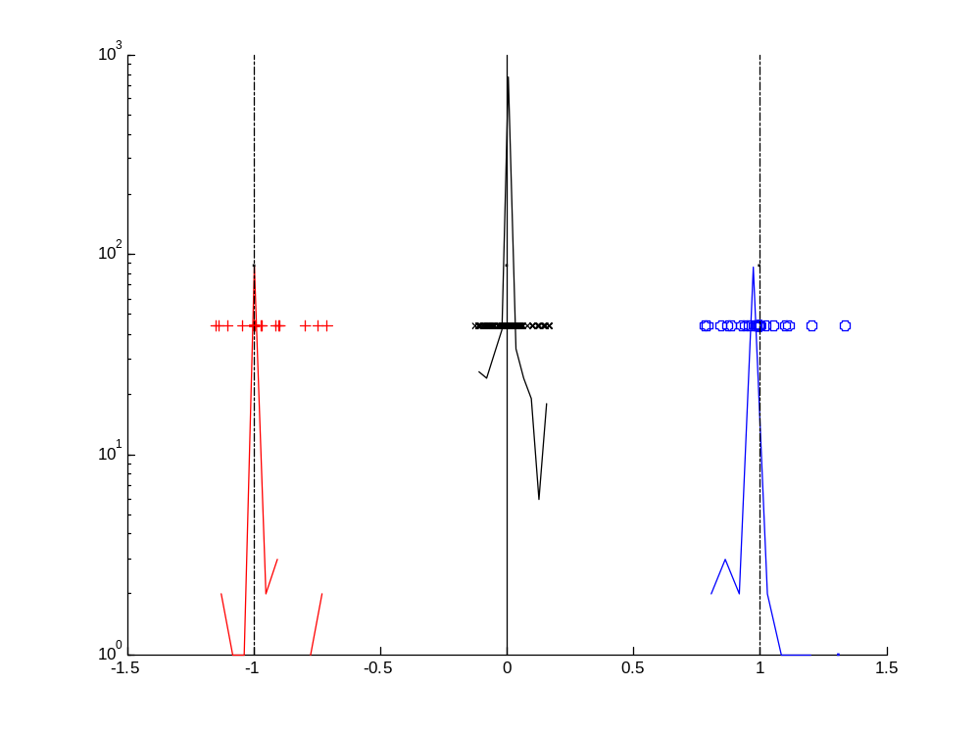
Histogram of projections and RA Universum
Typical histogram (for high-dimensional data)
Case 1:

Slide 62
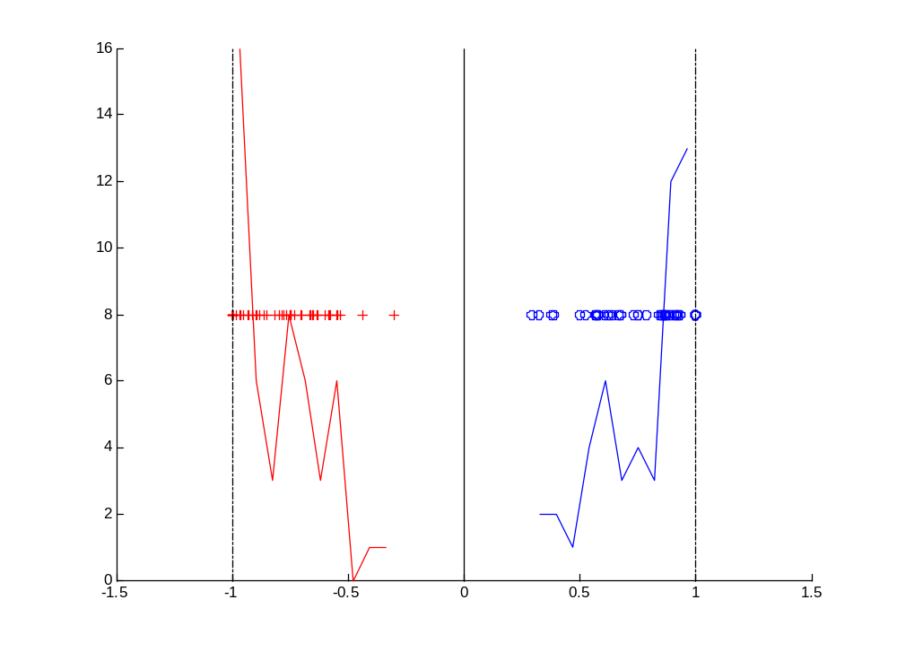
Histogram of projections and RA Universum
Typical histogram (for high-dimensional data)
Case 2:

Slide 63
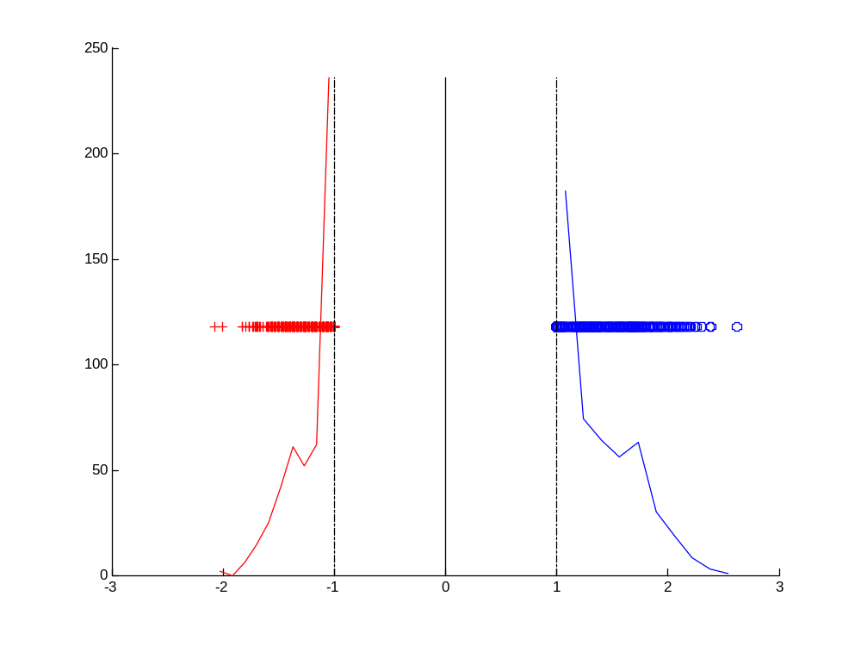
Histogram of projections and RA Universum
Typical histogram (for high-dimensional data)
Case 3:

Slide 64
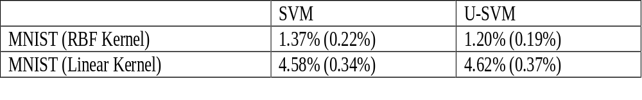
Example: Handwritten digits 5 vs 8
MNIST data set: each digit ~ 28x28=784 pixels
Training / validation set ~ 1,000 samples each
Test set ~ 1,866 samples
For U-SVM ~ 1,000 Universum samples (via RA)
Comparison of test error rate for SVM and U-SVM:

Slide 65
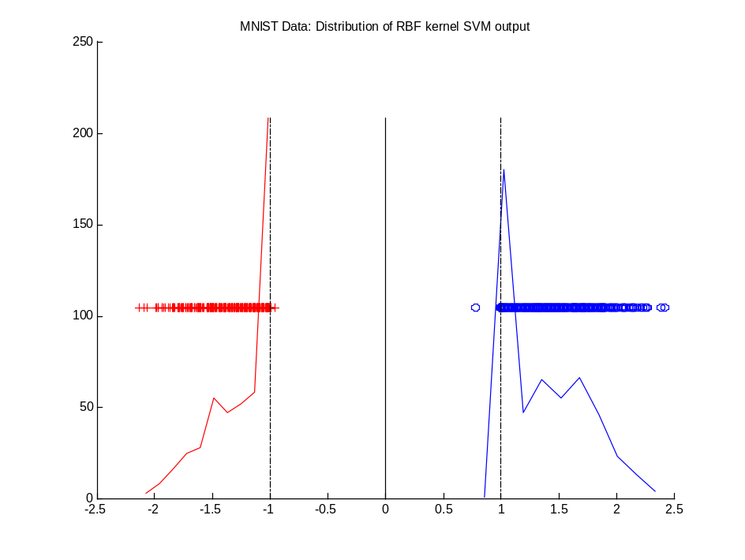
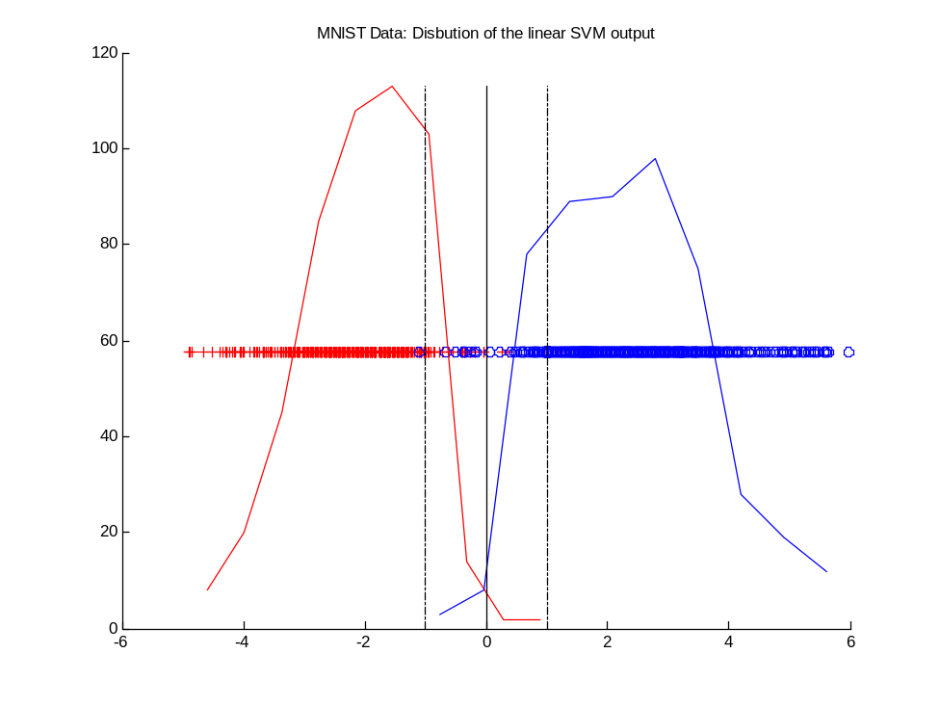
Histogram of projections for MNIST data
for RBF SVM for Linear SVM

Slide 66
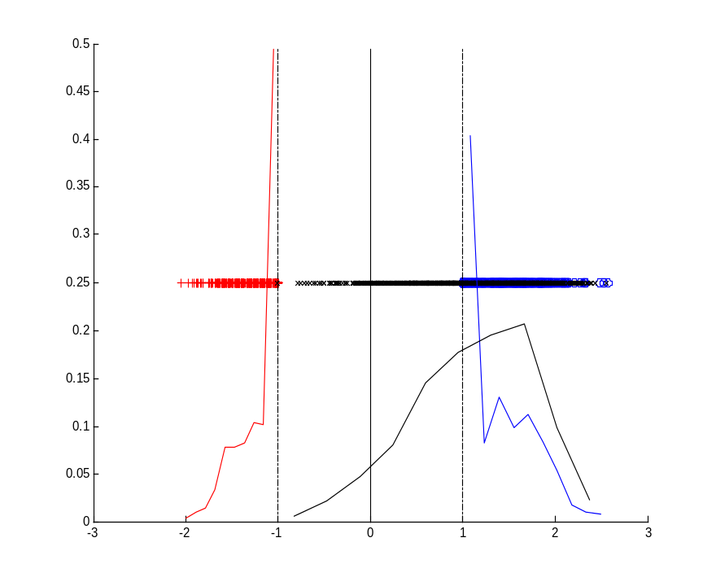
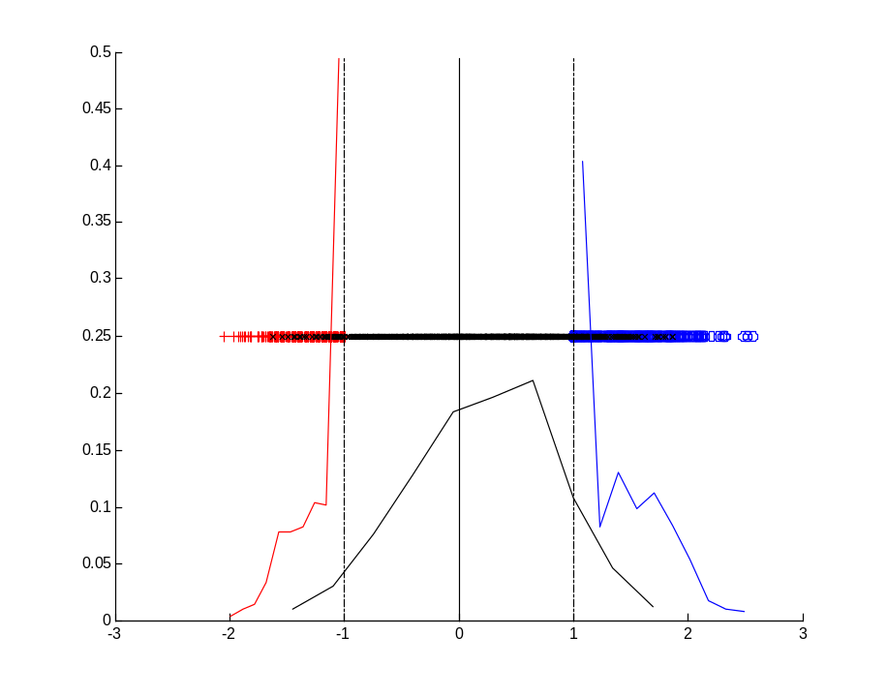
Analyzing ‘other digits’ Universum
The same set-up but using digits ‘1’ or ‘3’ Universa
Digit 1 Universum Digit 3 Universum
Test error: RBF SVM~ 1.47%, Digit1~1.31%, Digit3~1.01%

Slide 67
Summary & Discussion
Technical aspects: why the Universum data improves generalization when d>>n?
-SVM is solved in a low-dimensional subspace implicitly defined by the Universum data
How to specify good Universum?
- no formal procedure exists
- but conditions for the effectiveness of a particular Universum data set are known - see http://ieeexplore.ieee.org/stamp/stamp.jsp?tp=&arnumber=5936738
Psychological/cultural aspects:
- Relation to human learning (cultural Universum)?
- New type of inference? Impact on psychology?

Slide 68
Learning Using Privileged Info (LUPI)
Given: training data (x, x*, y)
where x* is privileged info provided by the Teacher only for training data
Estimate: predictive model y = f(x)
Note: two different Hilbert spaces x and x*
Additional info x* is common in many apps:
Handwritten digit recognition: ~verbal description (of digits)
Legal System: explanation of court decision (i.e., judge’s interpretation of facts and presented evidence)
Medical diagnosis: ~ medical history after initial diagnosis
Time series prediction: ~ future values of the training data

Slide 69
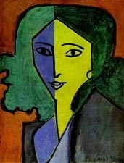
Learning Using Privileged Info (LUPI)
Given: training data (x, x*, y)
where x* is privileged info (only for training examples)
Estimate y = f(x) ~ same as in standard induction
Main Idea: additional info for training samples
standard learning: x LUPI: x + x*
+

Slide 70
Many Application Settings for LUPI
Medical diagnosis: privileged info ~ expensive test results, patient history after diagnosis, etc.
Time series prediction: privileged info ~ future values of the training time series
Additional group information (~ structured data)
Feature selection etc.
SVM+ is a formal mechanism
for training under LUPI setting

Slide 71
LUPI and SVM+ (Vapnik 2006)
SVM+ is a new learning technology for LUPI
Improved prediction accuracy (proven both theoretically and empirically)
Similar to learning with a human teacher: ‘privileged info’ ~ feedback from an expert teacher (can be very useful)
SVM+ is a promising new technology
Computationally difficult: no public domain software is readily available

Slide 72
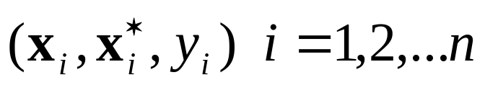
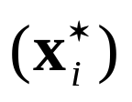

LUPI Formalization and Challenges
LUPI training data in the form
Privileged Info
- assumed to have informative value (for prediction)
- not available for testing/predictive model
Interpretation of the privileged info
- additional feedback from an expert teacher, different from ‘correct answers’ or y-labels
- this feedback provided in a different space x*
Challenge: how to handle/combine learning in two different feature spaces?

Slide 73


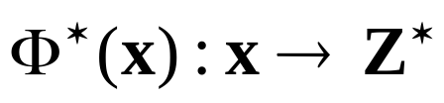
SVM+ Technology for LUPI
LUPI training data in the form
SVM+ Learning takes place in two spaces:
- decision space Z where the decision rule is estimated
- correction space Z* where the privileged info is encoded in the form of additional constraints on errors (slack variables) in the decision space
SVM+ approach implements two (kernel) mappings
- into decision space
- into correction space
- assumed to have informative value (for prediction)
- is not available for predictive model
Interpretation of privileged info
- additional feedback from an expert teacher, different from ‘correct answers’ or y-labels
- human interaction in a different feature space x*
Challenge: how to handle/combine learning in two different feature spaces?

Slide 74
Two Objectives of SVM+ Learning
(SVM+ Goal 1)
- separate labeled training data in decision space Z using large-margin hyperplane (as in standard SVM)
(SVM+ Goal 2)
- incorporate the privileged information in the form of additional constraints on slack variables in the decision space. These constraints are modeled as linear functions in the correction space Z*

Slide 75





SVM+ or Learning With Structured Data (hidden info = group label)
Correcting space
Correcting functions
mapping
Correcting space
mapping
Decision function
Decision space
Group1
Group2
Class 1
slack variable for group r
Class -1

Slide 76



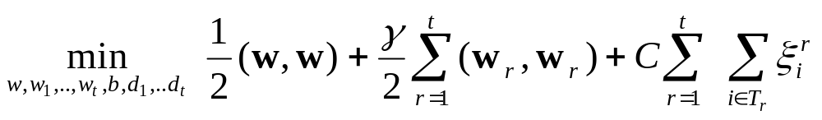
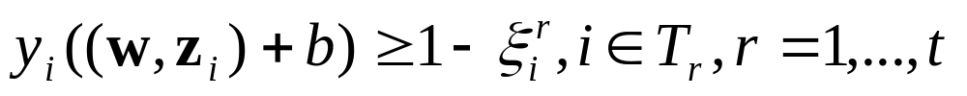

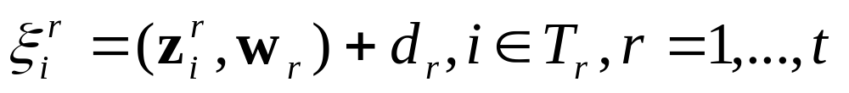
SVM+ Formulation
Decision Space
Correcting Space
subject to:

Slide 77



SVM+ Formulation
Map the input vectors simultaneously into:
- Decision space (standard SVM classifier)
- Correcting space (where correcting functions model slack variables for different groups)
Decision space/function ~ the same for all groups
Correcting functions ~ different for each group (but correcting space may be the same)
SVM+ optimization formulation incorporates:
- the capacity of decision function
- capacity of correcting functions for group r
- relative importance (weight) of these two capacities

Slide 78
OUTLINE
Motivation
New Learning Settings
Summary
- Advantages/limitations of non-standard settings
- Solving ill-posed problems
Knowledge discovery & machine learning

Slide 79
Advantages/Limitations of Nonstandard Settings
Advantages
- better reflects application requirements
- follows methodological framework (VC-theory)
- yields better generalization (but not always)
- new directions for research
Limitations
- formalization of application requirements → need to understand application domain
- more complex learning formulations
- possibly, more difficult model selection
- just a few empirical comparisons (to date)

Slide 80
Solving ill-posed estimation problems
• Making inferences from finite data
~ always ill-posed problem
→ need to ask the right question, yielding a better-posed problem ~ non-standard problem settings
Three types of restrictions for ill-posed problems (Vapnik, 2006):
(1) regularization (constraint on function smoothness)
(2) SRM ~ constraint on VC-dimension of models
(3) constraints on the mode of inference (~ problem setting)

Slide 81
Knowledge Discovery & Machine Learning
Scientific Knowledge (last 3-4 centuries):
- objective
- recurrent events (repeatable by others)
- quantifiable (described by math models)
Search for assured knowledge
Knowledge ~ causal, deterministic, logical
Humans cannot reason well about
- noisy/random data
- multivariate (high-dimensional) data

Slide 82
Philosophical Aspects of Knowledge
Idealism: knowledge is pure thought
Realism: knowledge comes from experience
Western History of knowledge
- Ancient Greece ~ idealism
- Classical science ~ realism
But it is not possible to obtain assured knowledge from empirical data (Hume):
Whatever in knowledge is of empirical nature is never certain

Slide 83
Digital Age
Most knowledge in the form of data from sensors (not human sense perceptions)
How to get assured knowledge from data?
Popular view ~ Big Data:
more data → more knowledge
more connectivity → better knowledge
Naïve realism based on
classical statistics + classical science

Slide 84
Alternative Philosophical Views
Karl Popper: Science starts from problems, and not from observations
Werner Heisenberg :What we observe is not nature itself, but nature exposed to our method of questioning
Albert Einstein:
- God is subtle but he is not malicious.
- Reality is merely an illusion, albeit a very persistent one.

Slide 85
Predictive Data Modeling Philosophy
Good predictive models depend on:
- observed training data (realism)
- method of questioning (idealism)
Idealistic components (from Expert Teacher) e.g. Privileged Information, Statistical Invariants, application problem formalization (in general)
Single ‘correct’ empirical model cannot be estimated from data alone.
Good prediction does not imply causality.

Slide 86
Predictive Modeling Methodology
The same methodology applies to financial, biomedical, weather, marketing etc
Solid scientific basis (~ VC theory) vs. collection of heuristic algorithms
Interpretation of predictive models:
- big problem (is it possible at all ?)
- reflects the need for assured knowledge
- requires understanding of the predictive methodology and its assumptions, rather than just interpretable parameterization

Slide 87
Predictive Modeling Methodology (cont’d)
Predictive methodology may be applied to non-technical areas (everyday life decisions)
Lessons from philosophy and history:
- Amount of data grows exponentially, but the number of ‘big ideas’ remains small
- Critical thinking ability becomes even more important in the digital age
- Freedom of information does not guarantee freedom of thought

